Slide 1
Study of Muon Neutrino Oscillations Using MicroBooNE Data
Herbie Warner
Ian Osborne

Slide 2
Objectives of the Experiment
Use Monte Carlo simulations and closure tests to produce realistic datasets
Use machine learning to apply intelligent selection cuts to datasets
Analyse MicroBooNE data to explore the possibility of a fourth neutrino flavour

Slide 3
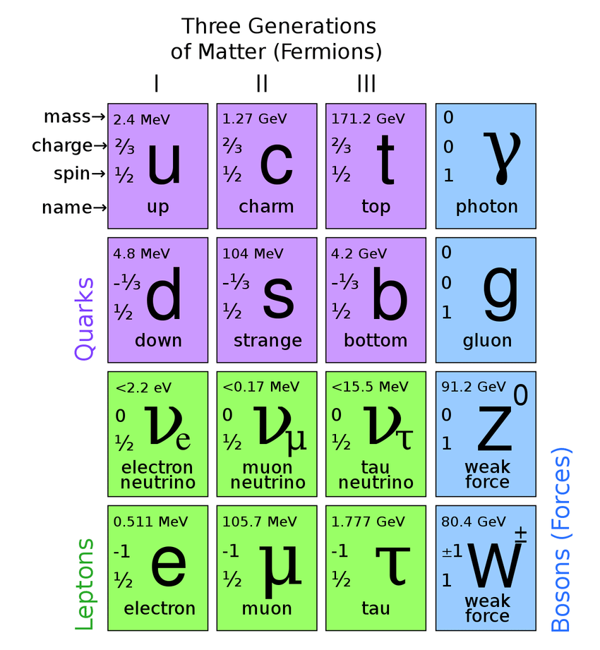
Neutrinos in the Standard Model
Family: Leptons
Mass: < 0.17 MeV
Charge: Neutral
Spin: ½
Interaction: Weak interaction
Flavours: Electron, Muon, Tau
Production: Sun, cosmic rays, accelerators
[1]

Slide 4
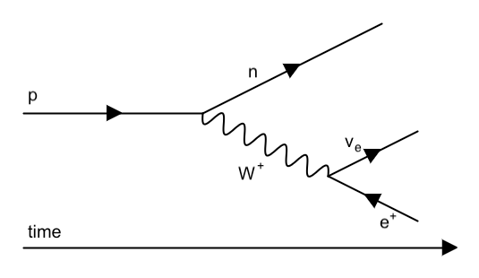
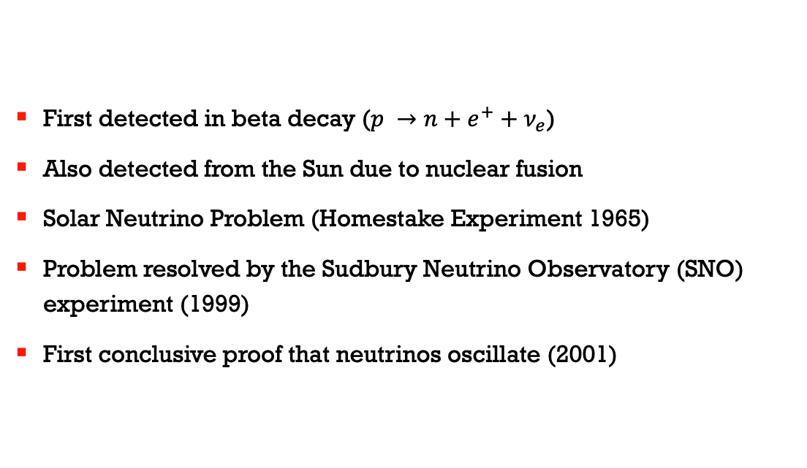
Neutrino Oscillations
First detected in beta decay ($p →n+e^{+}+ν_{e}$)
Also detected from the Sun due to nuclear fusion
Solar Neutrino Problem (Homestake Experiment 1965)
Problem resolved by the Sudbury Neutrino Observatory (SNO) experiment (1999)
First conclusive proof that neutrinos oscillate (2001)

Slide 5
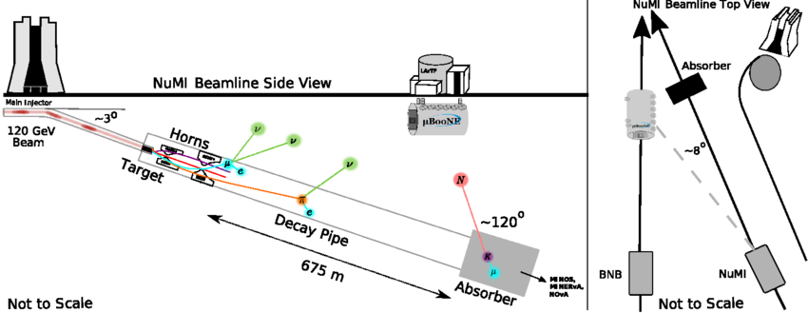
MicroBooNE Detector Setup
Booster Neutrino Beam (BNB)
Neutrino beam from Main Injector (NuMI)
120 GeV protons hit graphite target producing charged particles
Electromagnetic horns focus the charged particles
Charged particles decay into neutrinos along decay pipe
Flux from neutrinos in decay pipe as well as absorber
[2]

Slide 6
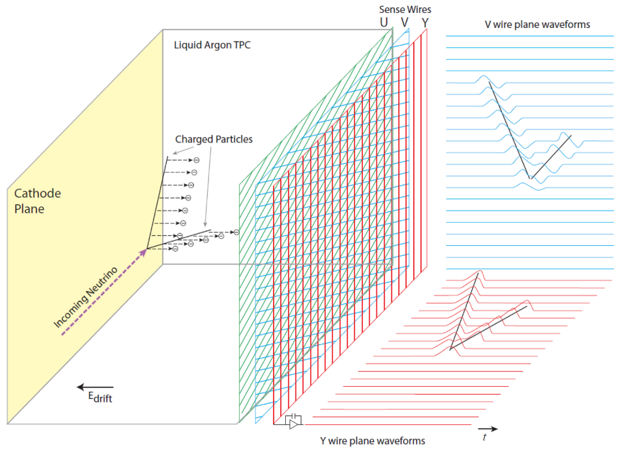
Time Projection Chamber
Liquid Argon TPC
3 planes of TPC wires with 3 mm spacing at angles of 0, and ± 60 degrees
32 8-in. photomultiplier tubes (PMTs) collect scintillation light produced by argon ionization
[3]

Slide 7
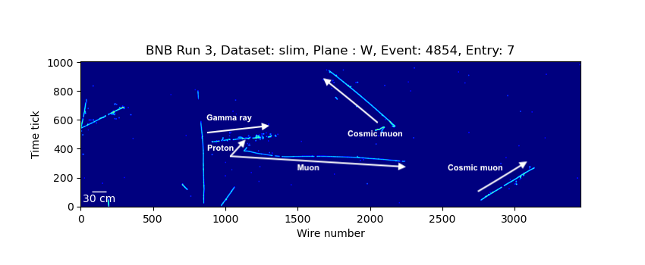
Event Display Example (Y plane)

Slide 8
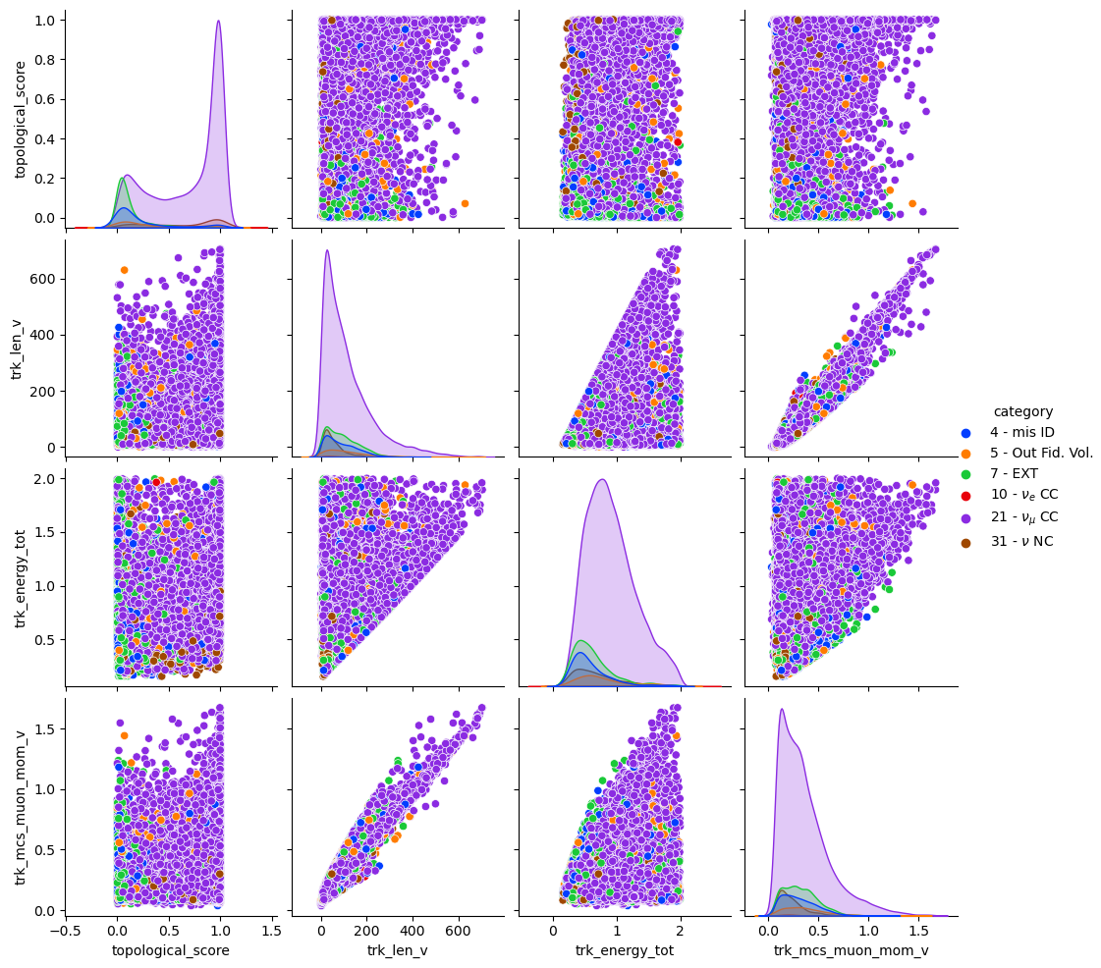
Data Correlations

Slide 9
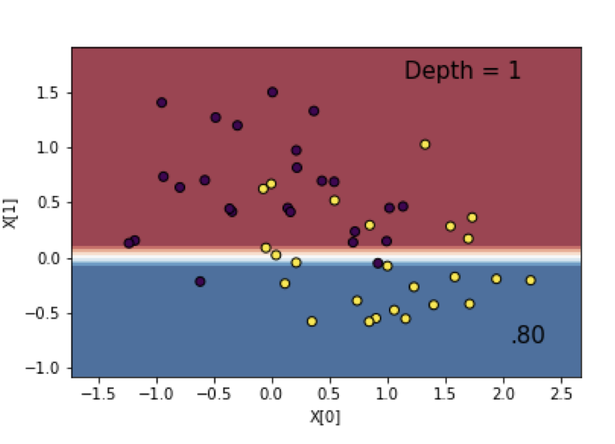
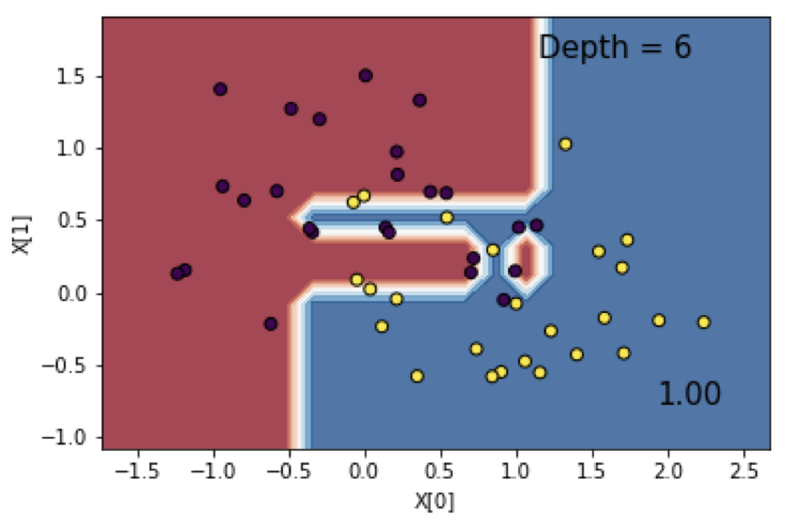
Decision Trees
Pros:
Simple machine learning model
Makes cuts for large sets of data across multiple variables
Captures non-linear patterns
Cons:
Prone to overfitting
Susceptible to variance in data
Overfitting counteracted using random decision forests
[4]

Slide 10
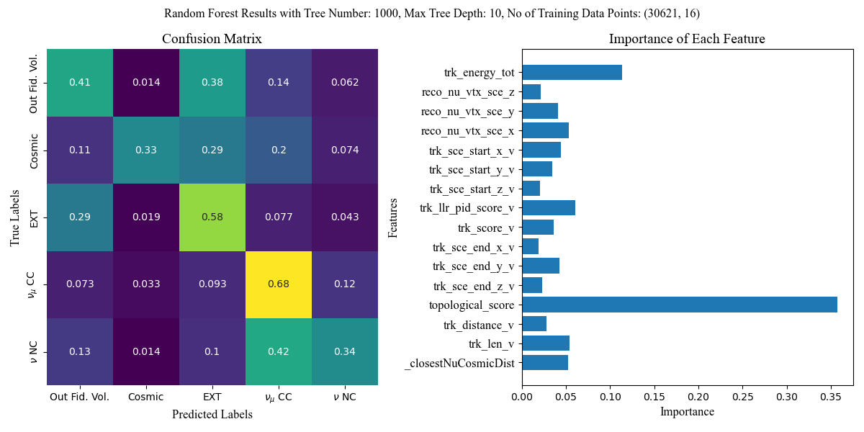
Confusion Matrix
High confusion in some categories
Topological score and track energy are the most important variables

Slide 11
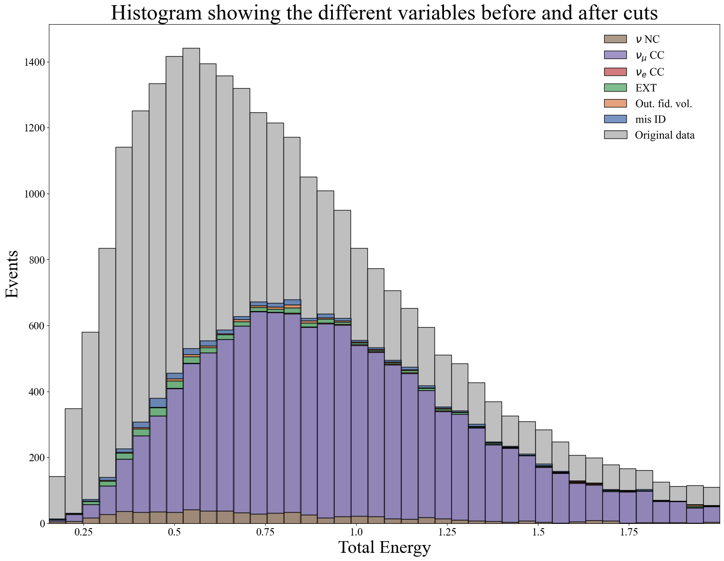
Filtering Data
Our aim is to remove background signals whilst keeping as many muon neutrino events as possible
This means keeping both efficiency and purity high
Cuts we make:
Track Energy: E < 2.0 GeV
Topological Score: TS > 0.4
Track Length: 0.0 cm < L < 600.0 cm
Reconstructed Vertex Position: Fiducial volume size
This gives efficiency = 0.515 and purity = 0.893
Plot shows difference in bin size before and after cuts

Slide 12
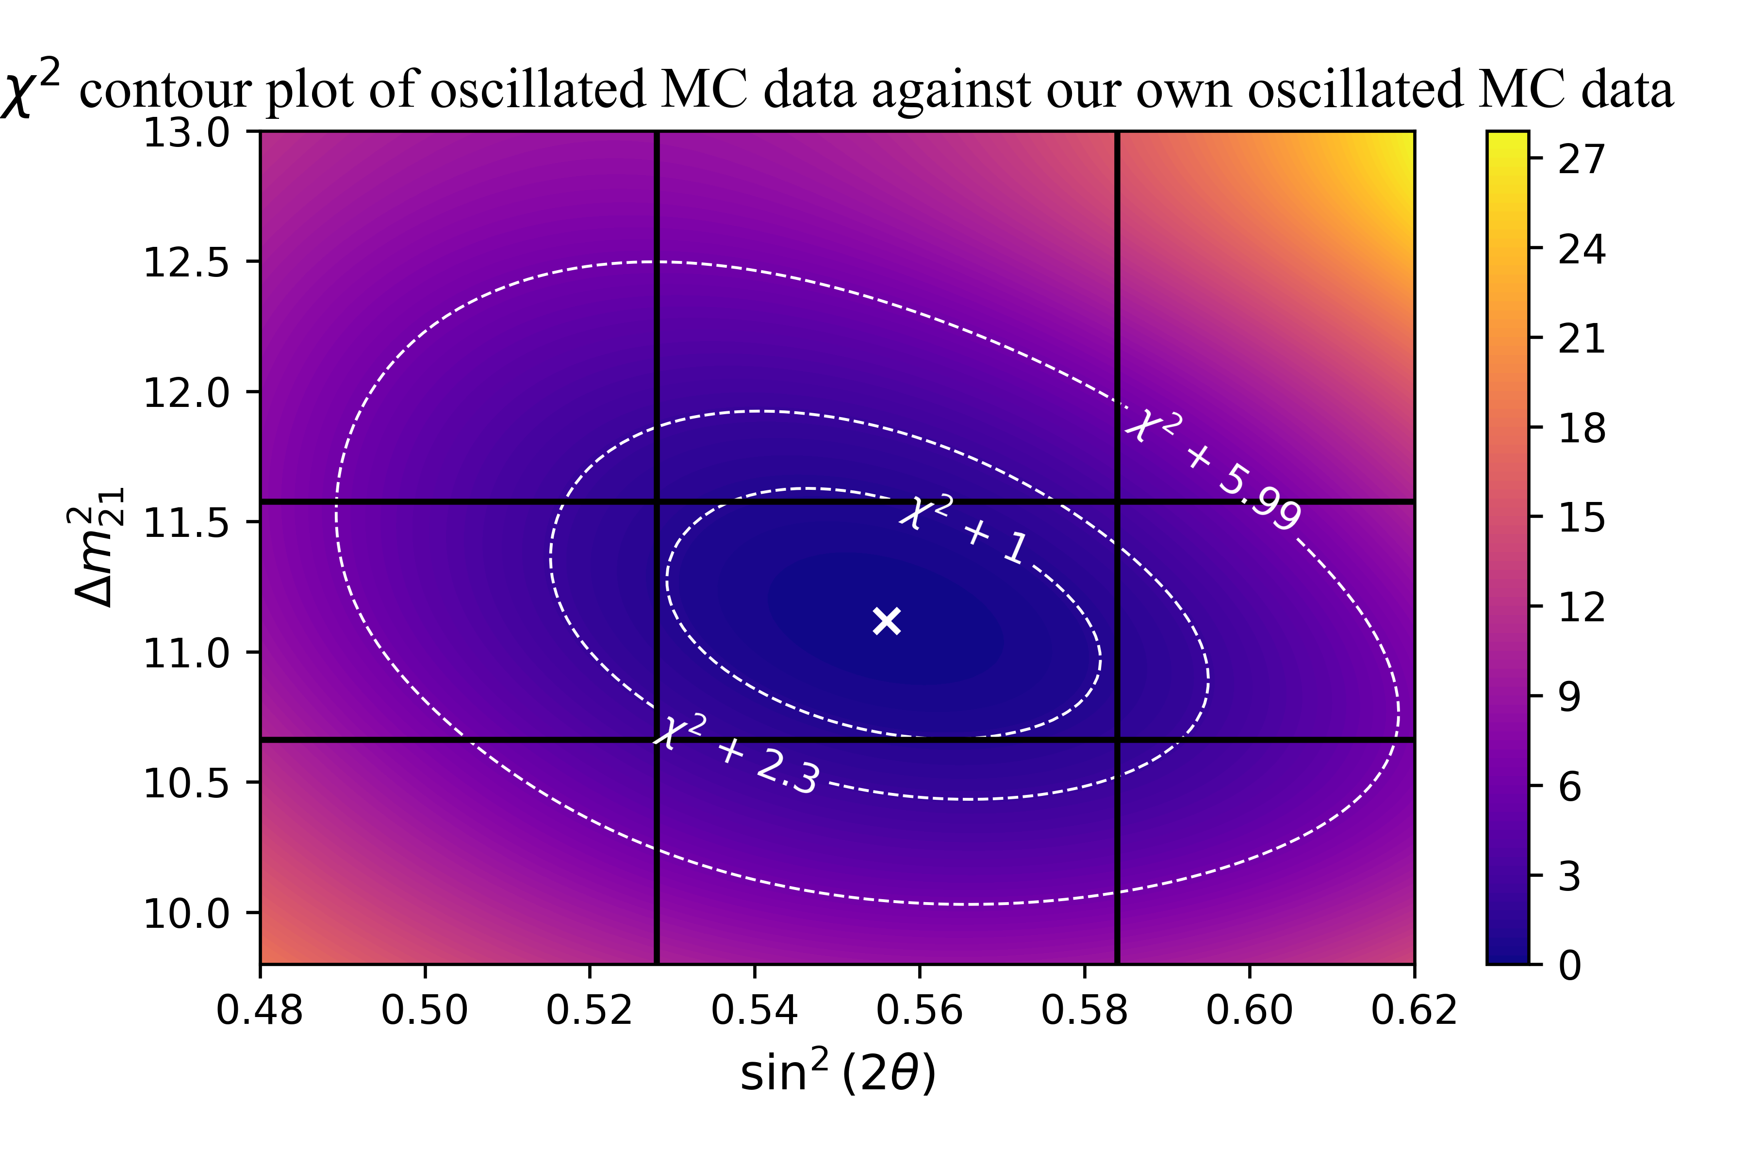
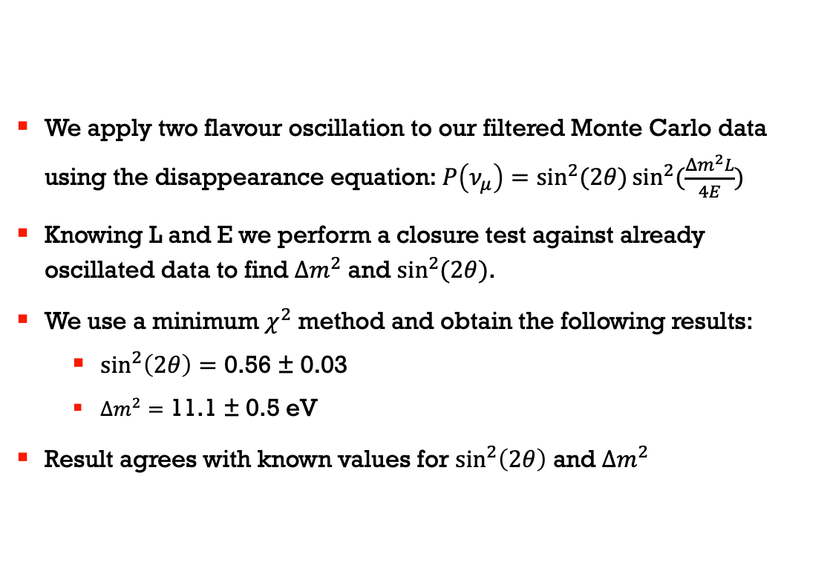
Checking Against 2 Flavour Oscillated Data
We apply two flavour oscillation to our filtered Monte Carlo data using the disappearance equation:$P\left(ν_{μ}\right)=\sin^{2}{(2θ)}\sin^{2}{(\frac{Δm^{2}L}{4E})}$
Knowing L and E we perform a closure test against already oscillated data to find $Δm^{2}$ and $\sin^{2}(2θ)$.
We use a minimum $χ^{2}$ method and obtain the following results:
$\sin^{2}\left(2θ\right)=\text{0.56 ± 0.03}$
$Δm^{2}=\text{11.1 ± 0.5} \text{eV}$
Result agrees with known values for $\sin^{2}\left(2θ\right)$ and $Δm^{2}$

Slide 13
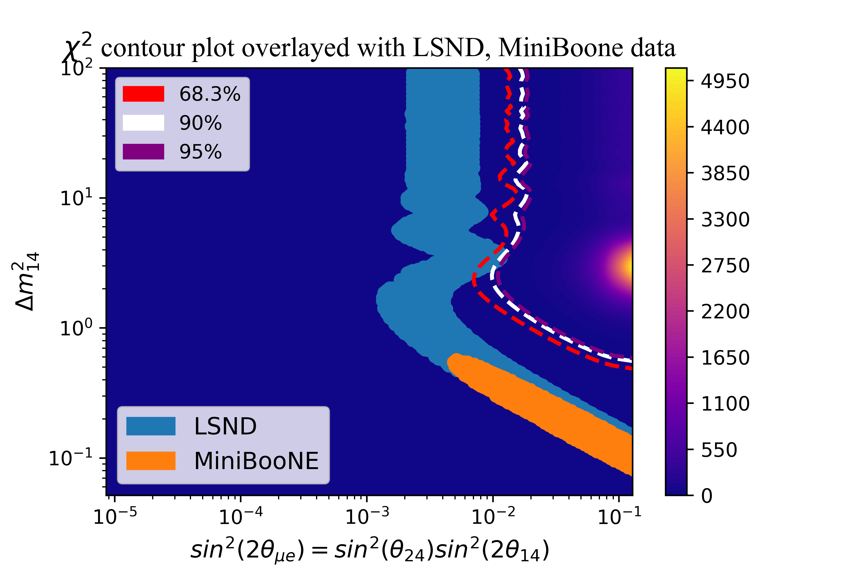
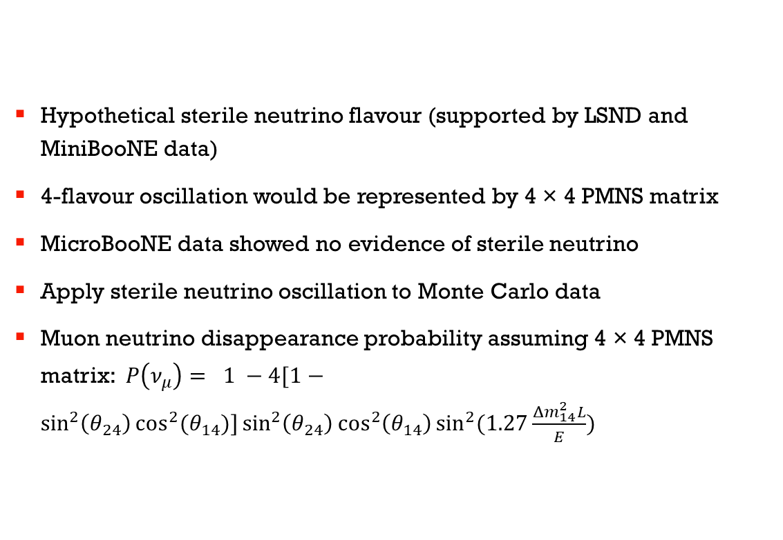
3 + 1 Neutrino Model
Hypothetical sterile neutrino flavour (supported by LSND and MiniBooNE data)
4-flavour oscillation would be represented by 4 × 4 PMNS matrix
MicroBooNE data showed no evidence of sterile neutrino
Apply sterile neutrino oscillation to Monte Carlo data
Muon neutrino disappearance probability assuming 4 × 4 PMNS matrix: $P\left(ν_{μ}\right)= 1 −4[1−\sin^{2}\left(θ_{24}\right)\cos^{2}{(θ_{14})]\sin^{2}\left(θ_{24}\right)\cos^{2}\left(θ_{14}\right)\sin^{2}{(1.27\frac{Δm_{14}^{2}L}{E}}})$

Slide 14
Histogram of Oscillated Data at Different Oscillation Parameters

Slide 15
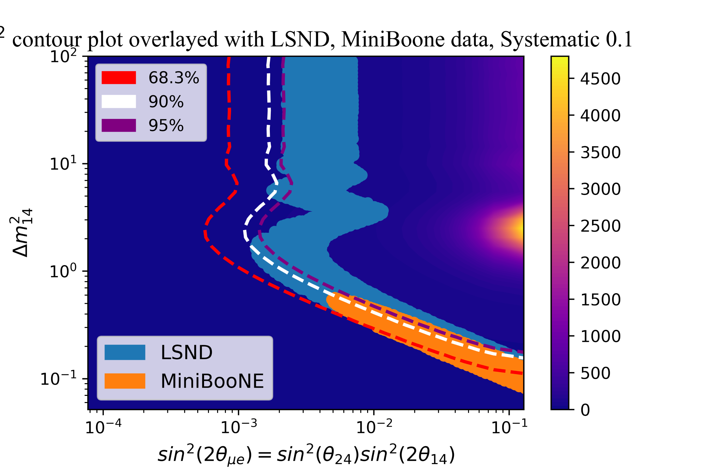
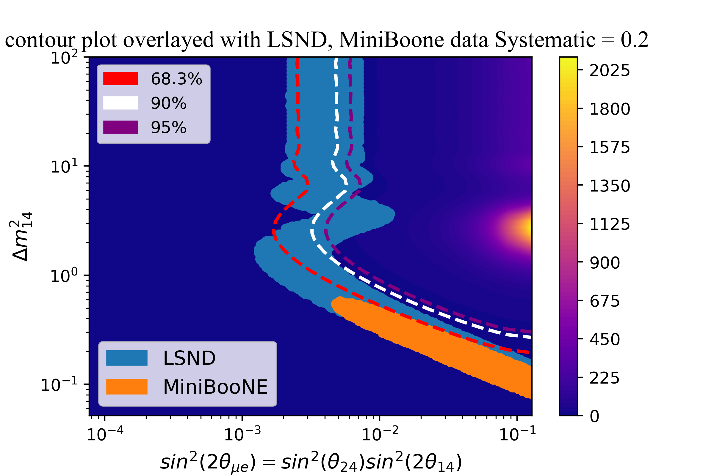
Errors
Statistical errors:
Assumes Poisson distributed data
Breaks down at small bin sizes
Systematic errors:
Geant4
Unpredictable nature of particles in the liquid argon (electrons and photons especially)
Calibration errors (calibrating components correctly)
Wire readout sensitivity
Energy scale and resolution
Contamination
Neutrino flux uncertainty
Assume flat 0.15 without covariance matrix

Slide 16

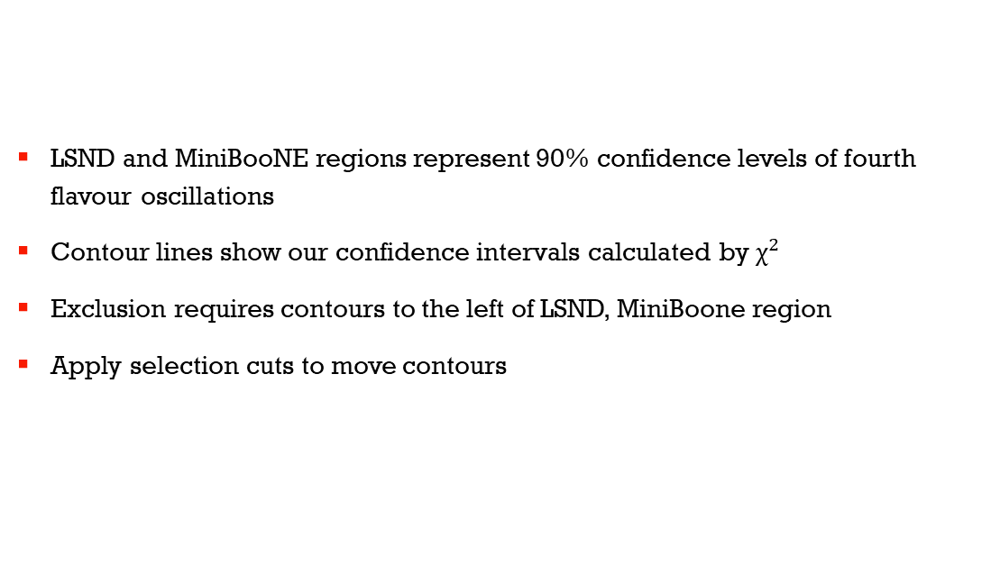
Goal of Our Extension
LSND and MiniBooNE regions represent 90% confidence levels of fourth flavour oscillations
Contour lines show our confidence intervals calculated by ${\text{χ}}^{2}$
Exclusion requires contours to the left of LSND, MiniBoone region
Apply selection cuts to move contours

Slide 17
Genetic Algorithm
Method for solving optimisation problems
Population consists of individuals
Individuals consists of unique selection cuts and metric of fitness
Individuals improve over generations
Converge on best individual
Create Initial Population
Score and Scale Population
Retain Elite
Select Parents
Produce Crossover and Mutation Children

Slide 18
Create Initial Population
Score and Scale Population
Retain Elite
Select Parents
Produce Crossover and Mutation Children

Slide 19

Performance of Genetic Algorithm
Best individual after 50 generations
Purity: 0.81
Efficiency: 0.17
Distance: 0.07
Best defined as combination of these

Slide 20
Neuroevolutionary Model
Create Initial Population
Train NN further
Neuroevolutionary AI
This consists of a GA coupled with a Keras Neural Network
NN trained on large set of individuals prior to GA initialization
Exact calculation of by χ2 metric takes time
NN used for rapid calculation of this
Score and Scale Population
Retain Elite
Evaluate Parameter Space
Select Parents
Generate Diversity
Produce Crossover
Predict Fitness with NN
If Bad
If Good
Mutate
If Bad
If Good

Slide 21
Create Initial Population
Train NN further
Score and Scale Population
Retain Elite
Evaluate Parameter Space
Select Parents
Generate Diversity
Produce Crossover
Predict Fitness with NN
If Bad
If Good
Mutate
If Bad
If Good

Slide 22
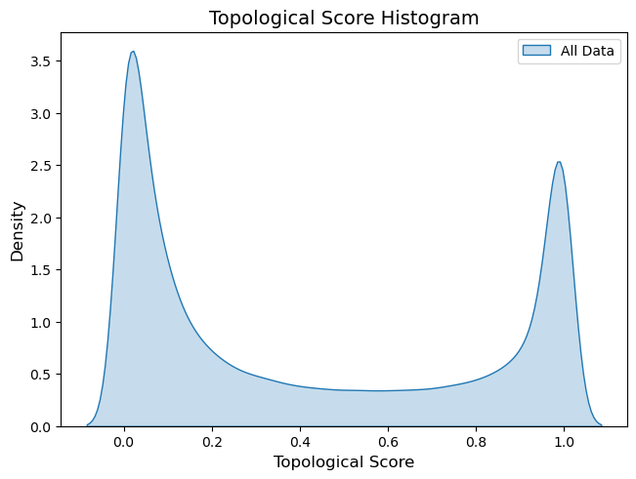
Alternate Representations of Selection Cuts
0.4 ≤ T ≤ 0.5, 0.9 ≤ T ≤ 1.0
0 0 0 0 1 0 0 0 0 1
NN performs badly with cuts represented by numbers
Posit new representation to better encode spatial relations
Map new representation with density functions to encode the importance of each element
0 0 0 0 0 0 0 0 1 1
0 0 0 1 1 0 0 0 0 0 0

Slide 23
0.4 ≤ T ≤ 0.5, 0.9 ≤ T ≤ 1.0
0 0 0 0 1 0 0 0 0 1
0 0 0 0 0 0 0 0 1 1
0 0 0 1 1 0 0 0 0 0 0

Slide 24
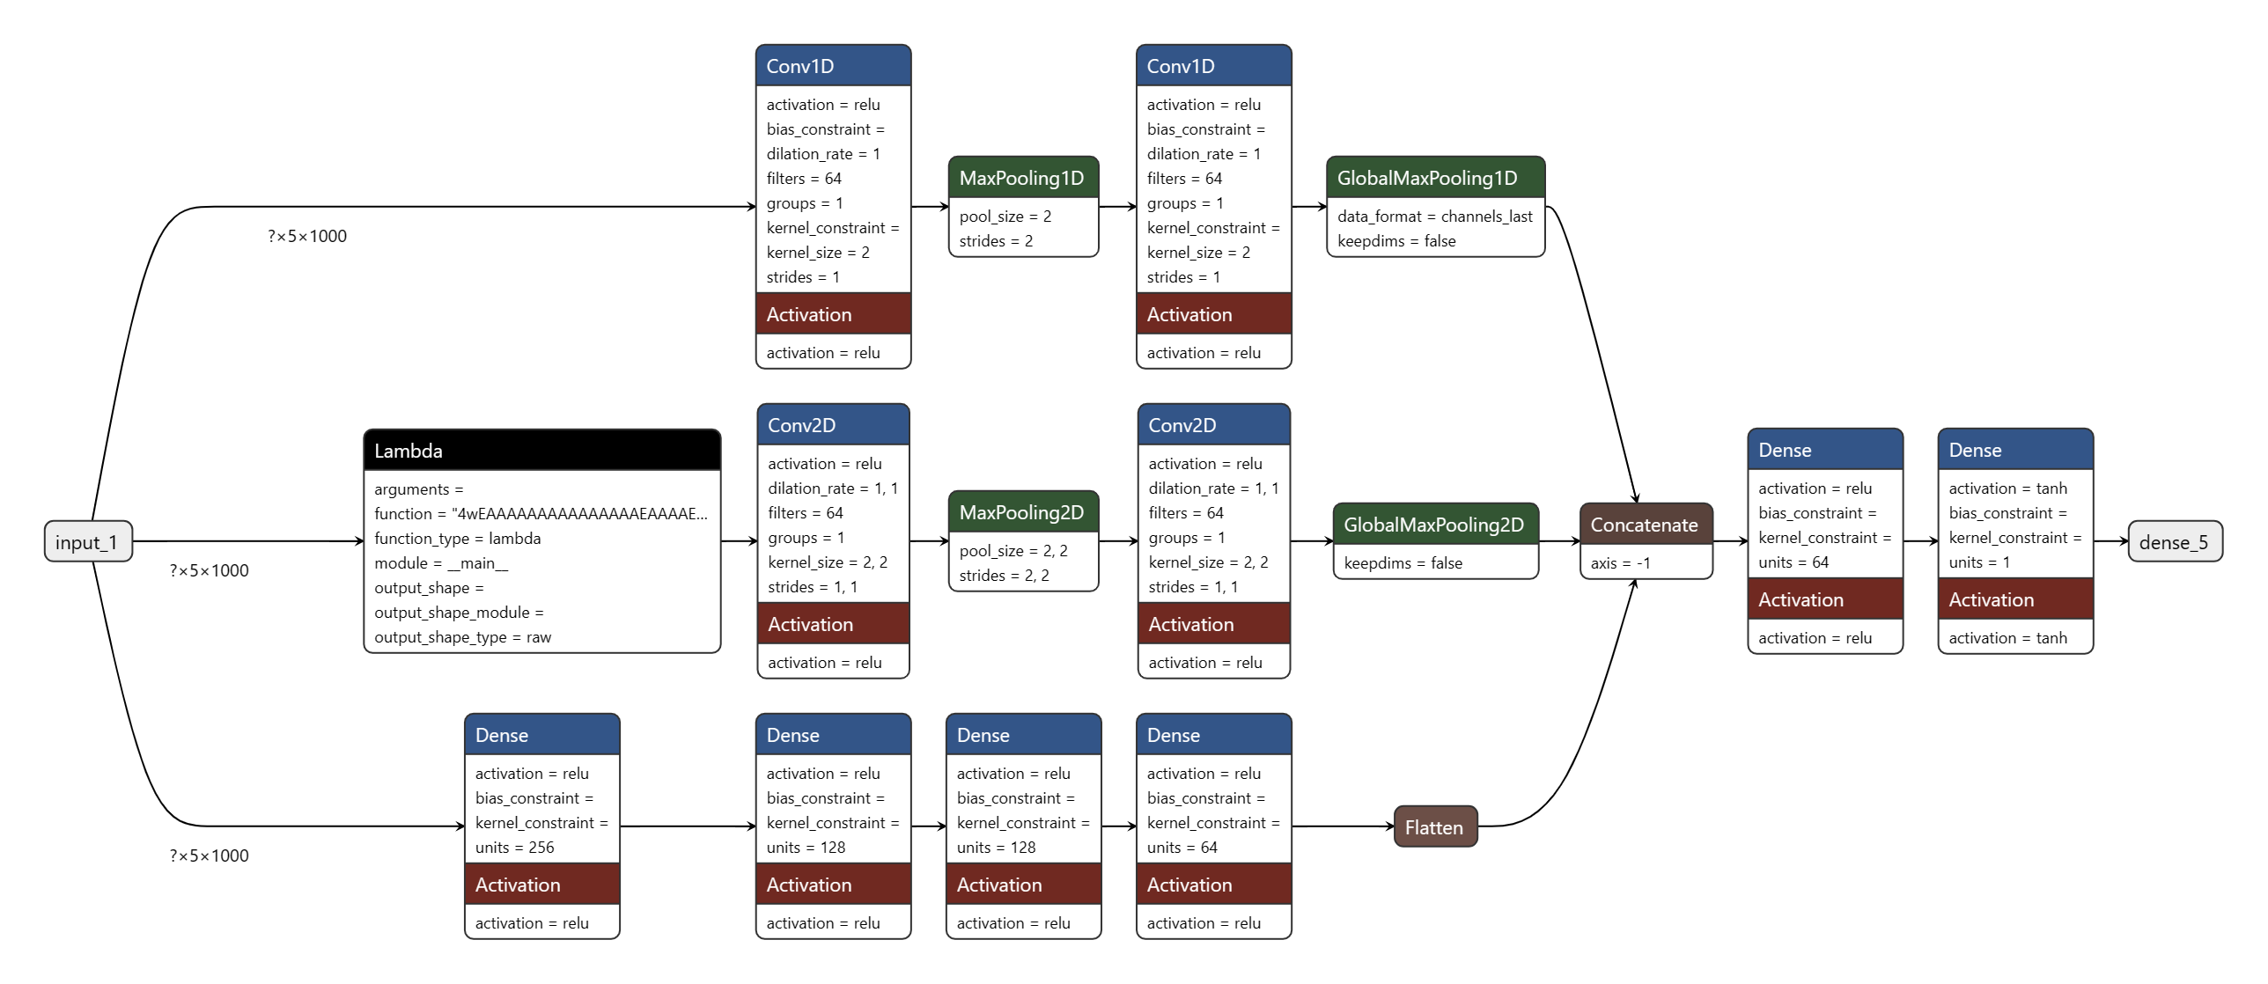
Structure of Hybrid CNN
Supervised learning
Hybrid combination of dense and convolutional layers
Single output between -1 and 1

Slide 25
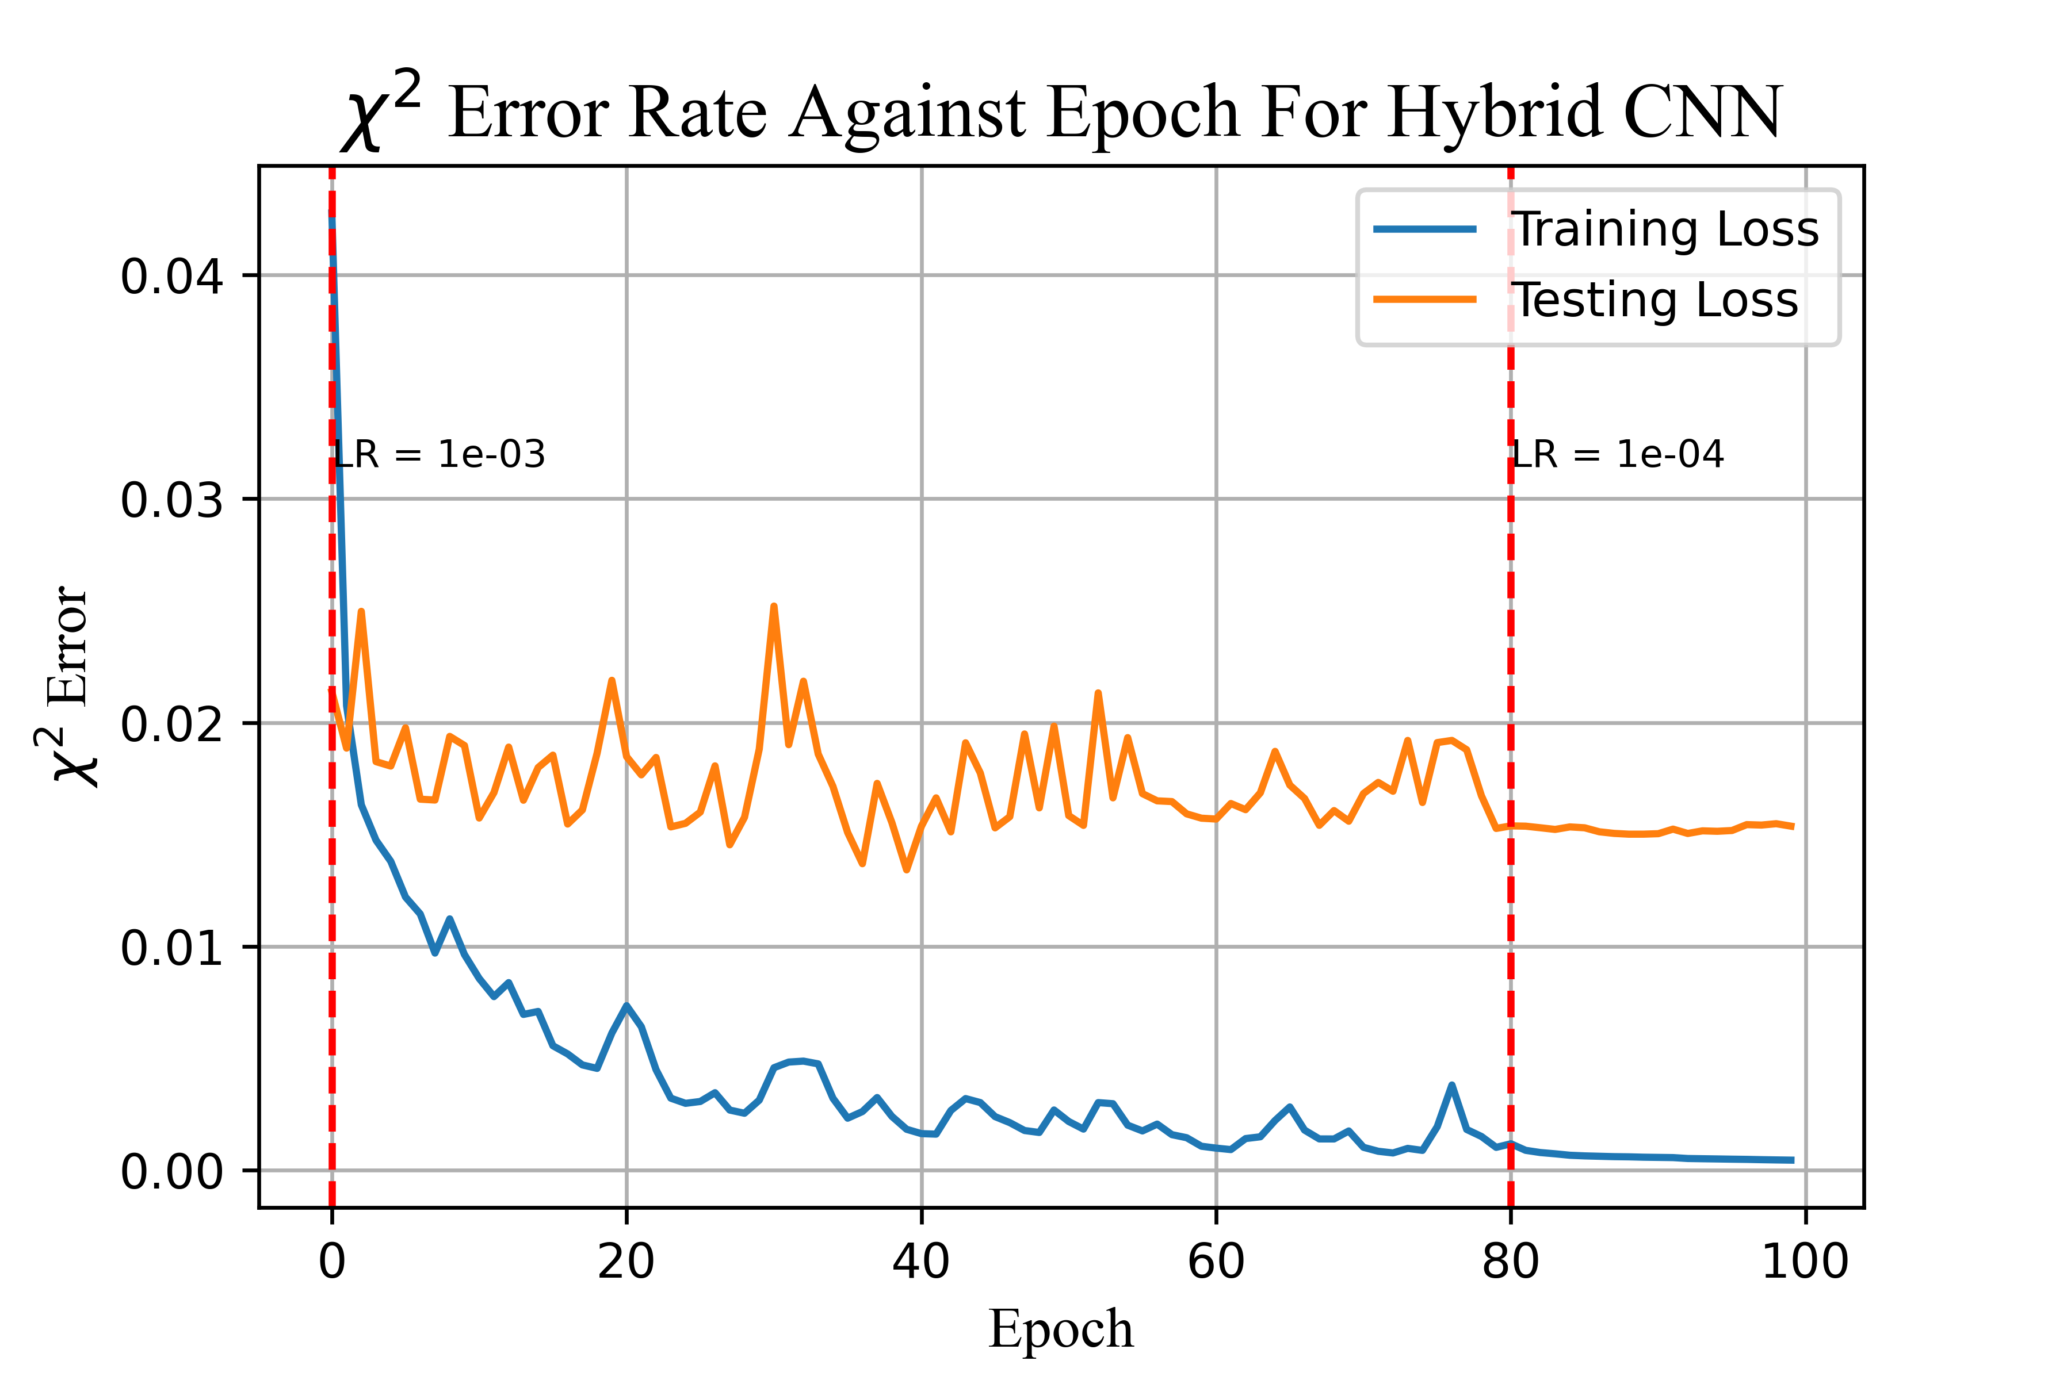
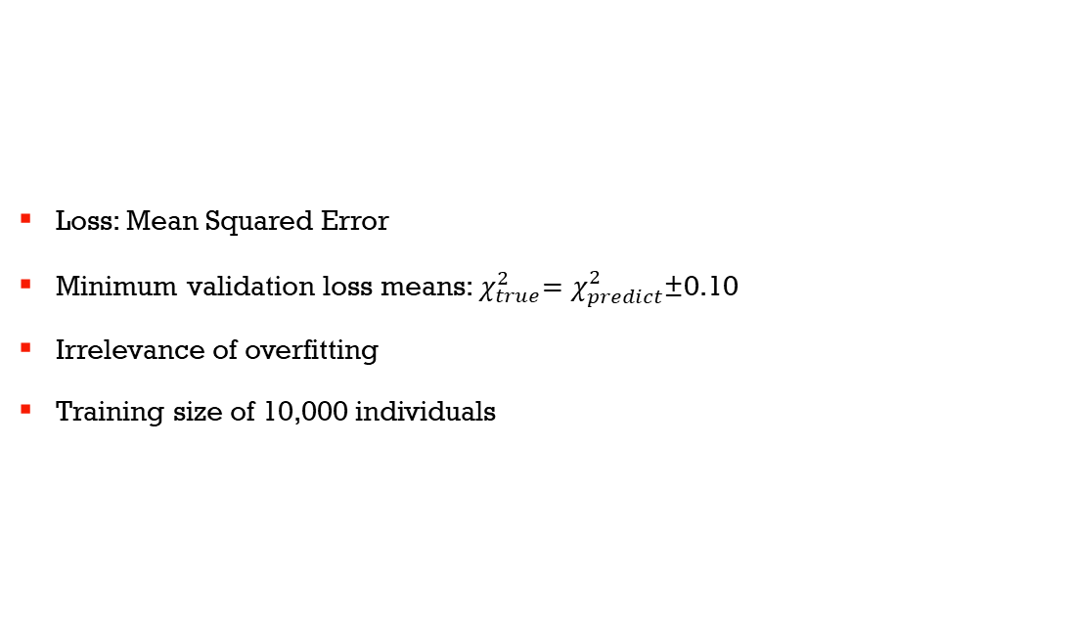
Performance of Hybrid CNN
Loss: Mean Squared Error
Minimum validation loss means:${ χ}_{true}^{2}=χ_{predict}^{2}\text{±}$0.10
Irrelevance of overfitting
Training size of 10,000 individuals

Slide 26
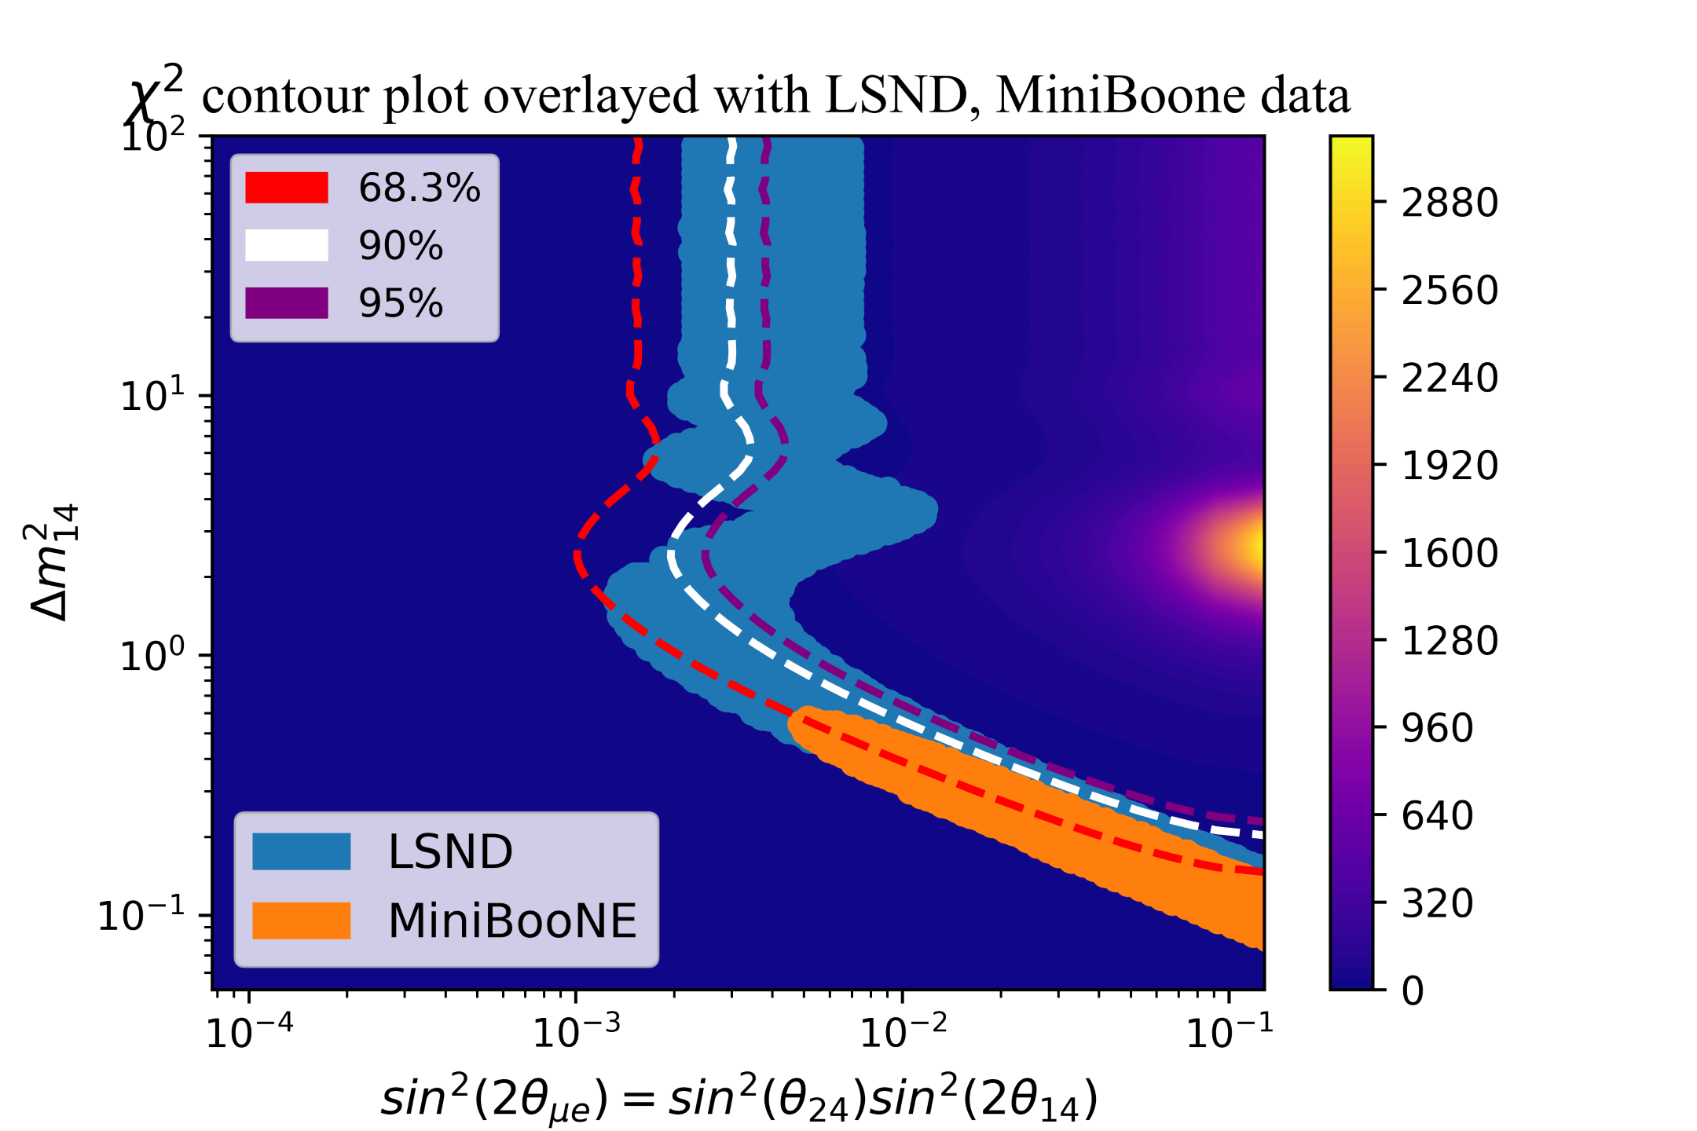
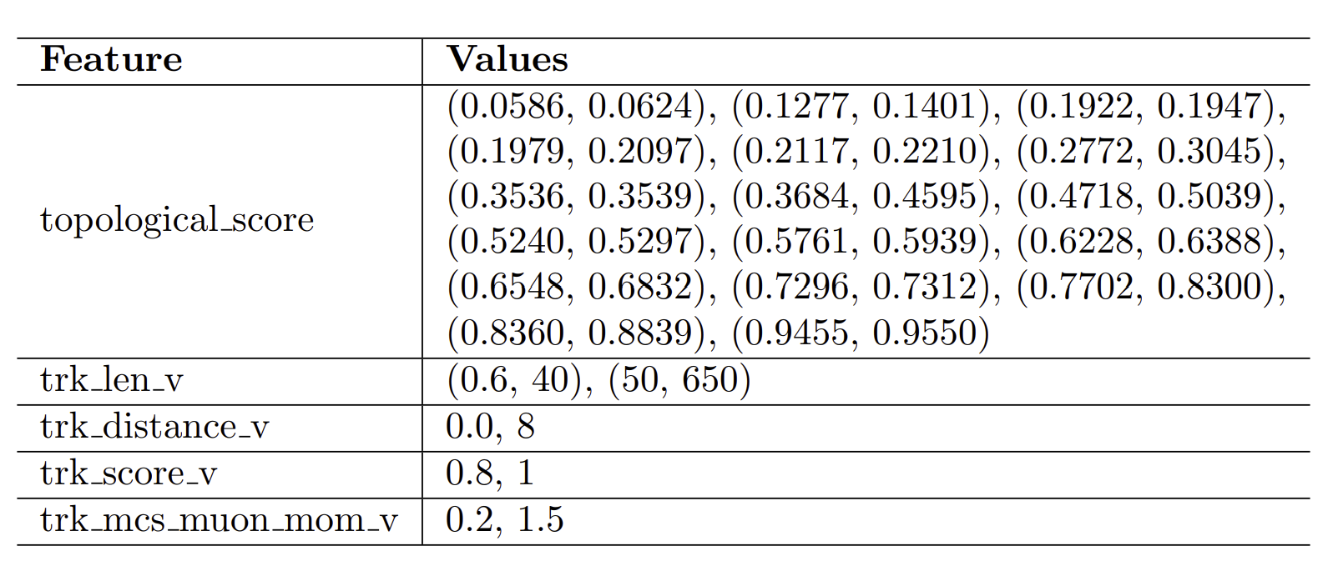
Results of the Neuroevolutionary Model
Purity 81%
Efficiency 13%
Distance -0.009
Previous best distance: 0.07

Slide 27

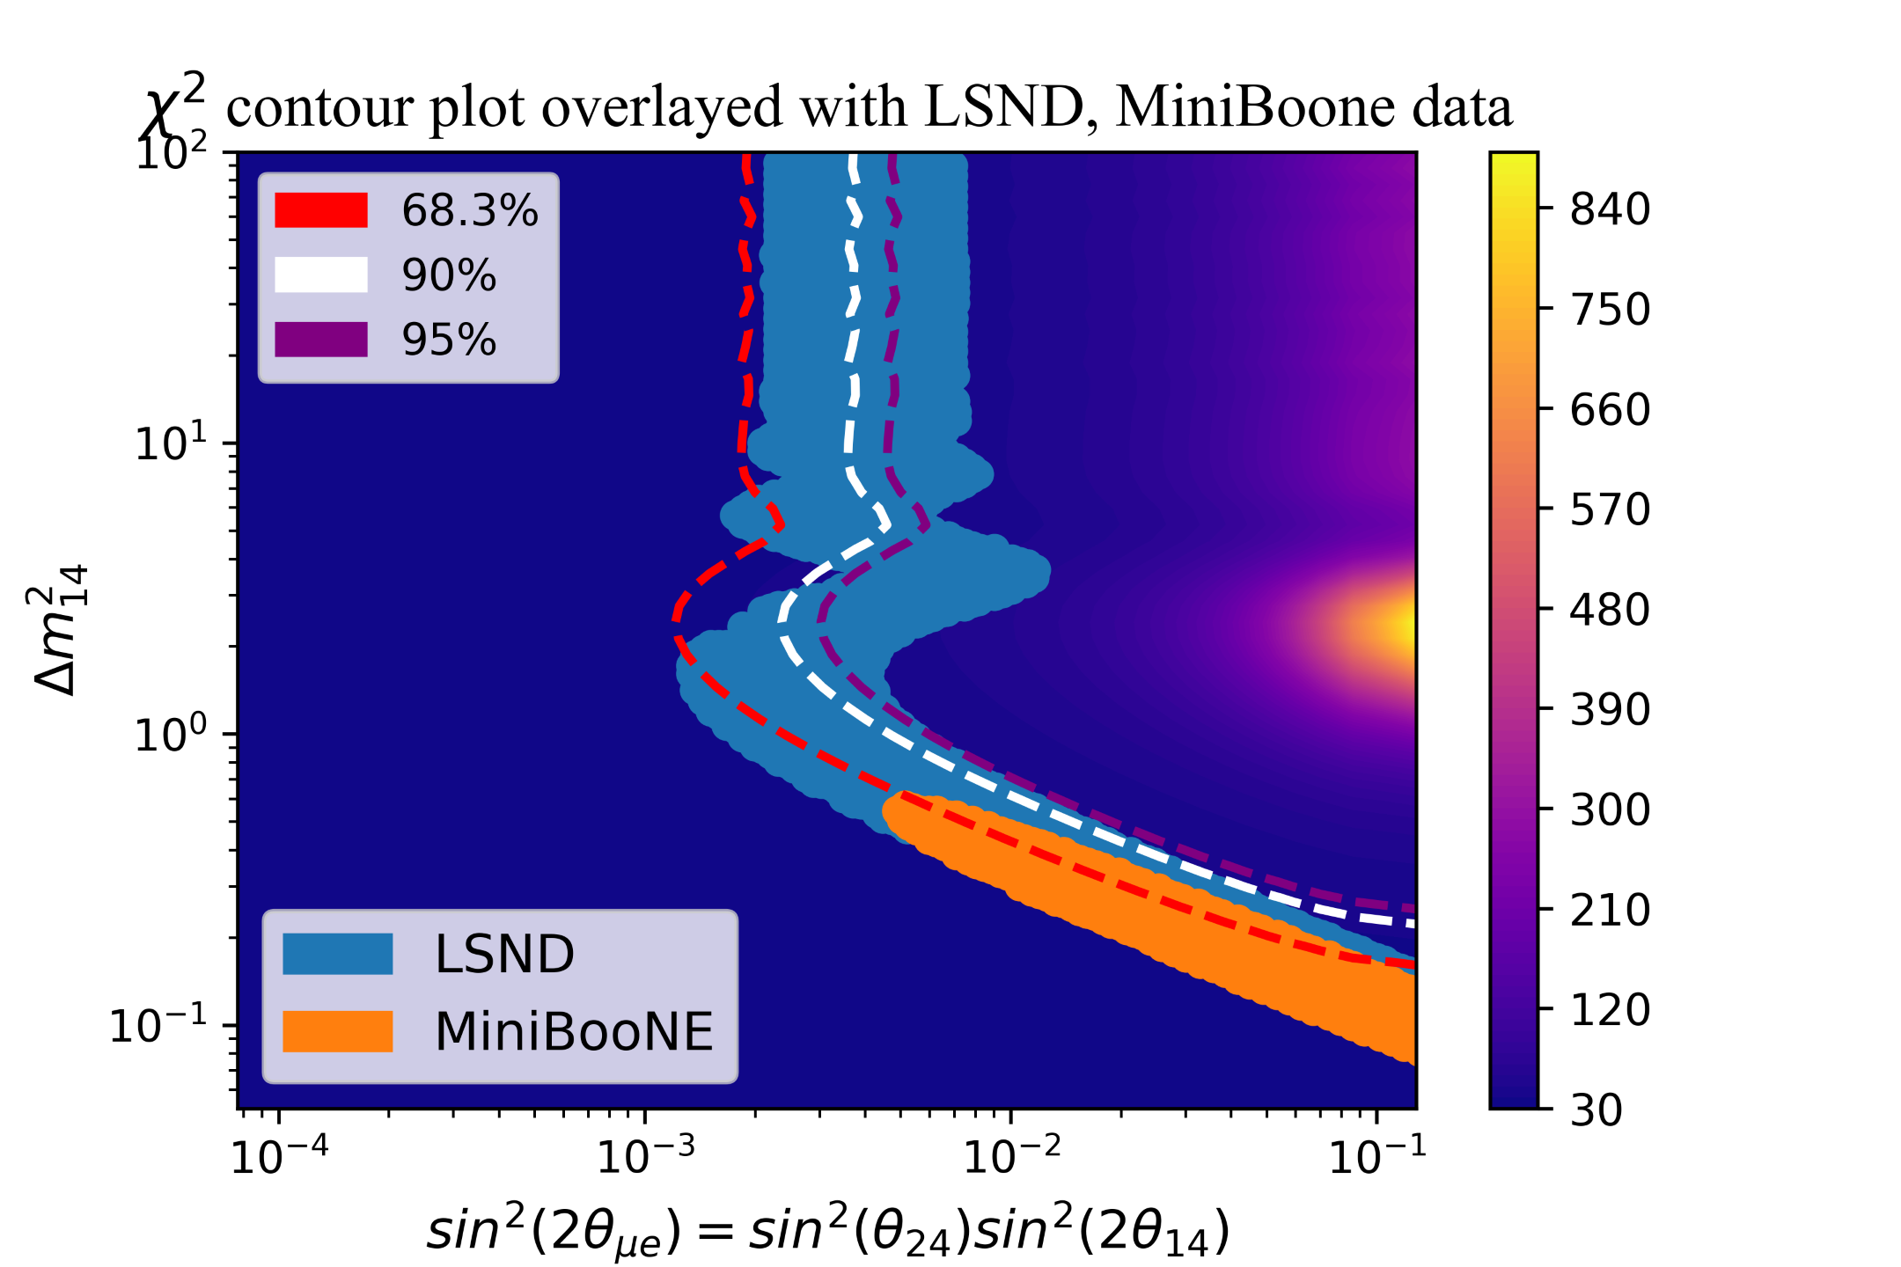
Other Interesting Individuals
Purity 96%
Efficiency 11%
Purity 63%
Efficiency 10%

Slide 28
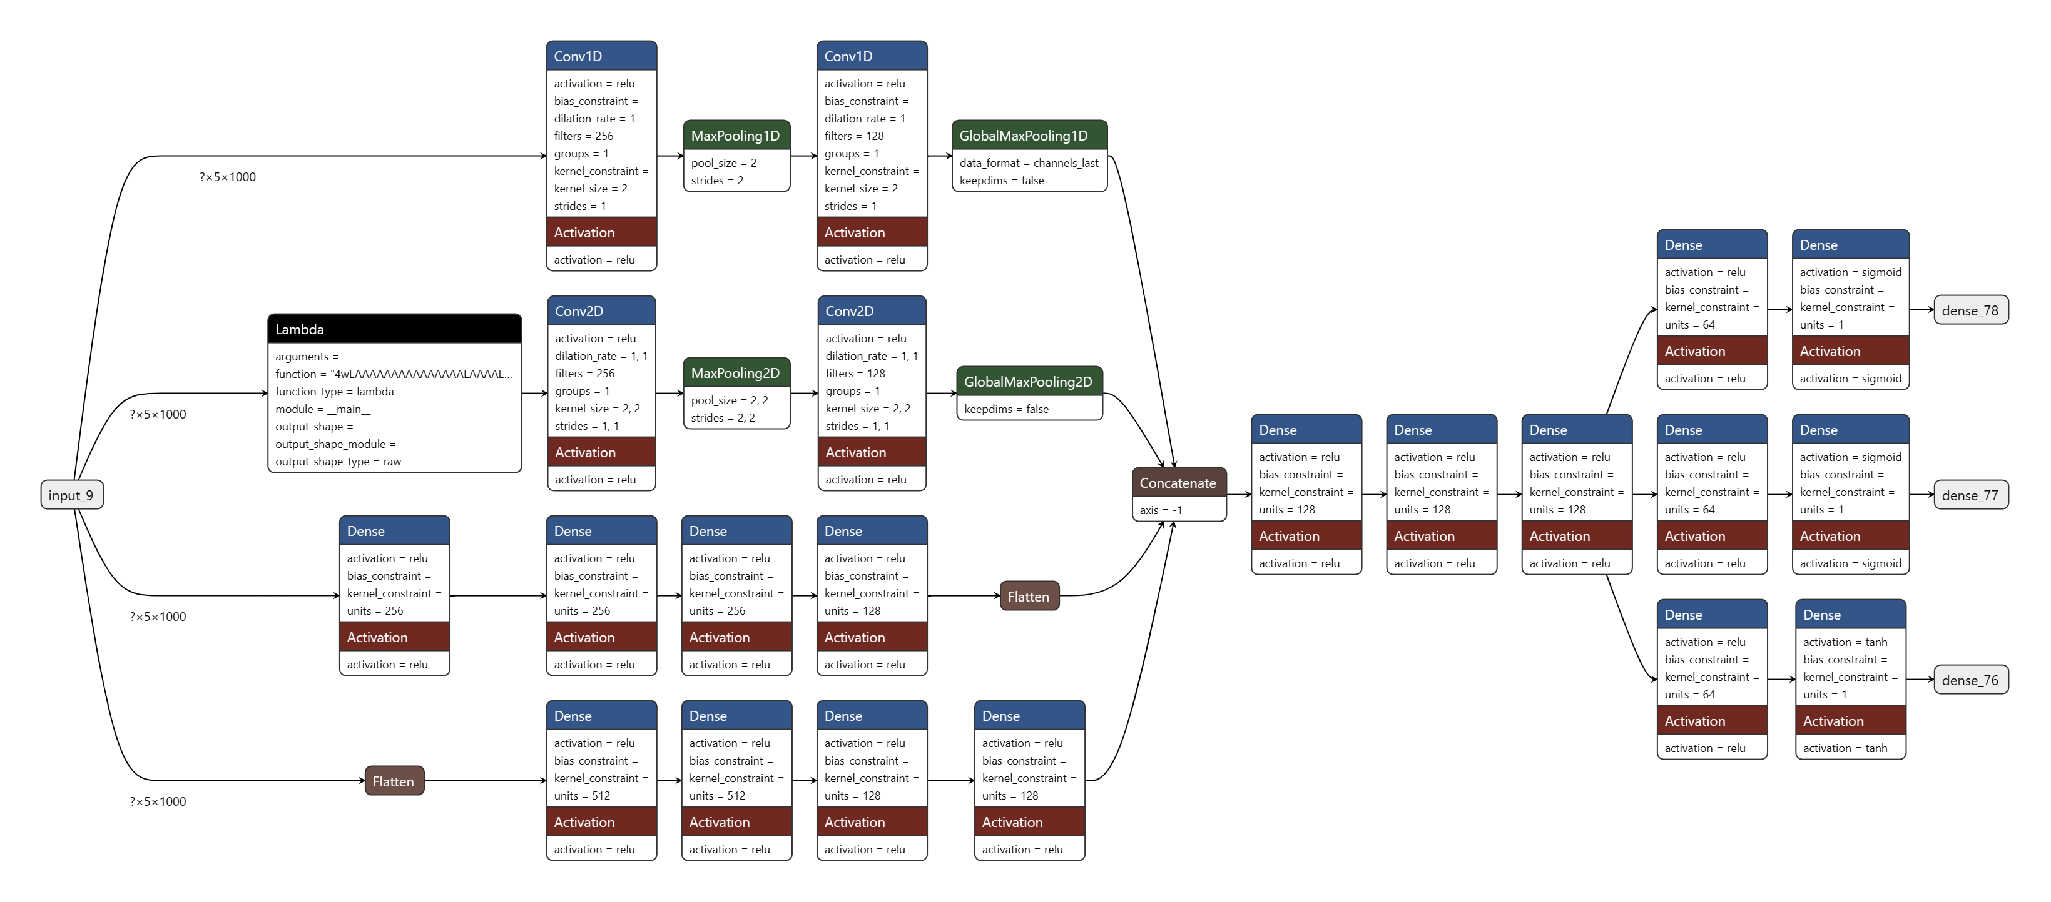
Methods to Improve our Results
?
Use both LSND and MiniBooNE to calculate fitness
Errors on NN predictions
Implement covariance matrices
Electron neutrino reappearance
Use more data
Further integration of the NN into the GA

Slide 29
References
[1] Developments in high energy theory - Scientific Figure on ResearchGate. Available from: https://www.researchgate.net/figure/A-table-of-the-Standard-Model-particles-showing-their-masses-mass-bounds-From-PBS-NOVA_fig4_45850970 [accessed 29 Nov, 2023]
[2] Search for long-lived heavy neutral leptons and Higgs portal scalars decaying in the MicroBooNE detector - Scientific Figure on ResearchGate. Available from: https://www.researchgate.net/figure/Illustration-of-the-position-of-the-MicroBooNE-detector-relative-to-the-NuMI-target-and_fig1_365809696 [accessed 29 Nov, 2023]
[3] Design and Construction of the MicroBooNE Detector - Scientific Figure on ResearchGate. Available from: https://www.researchgate.net/figure/Operational-principle-of-the-MicroBooNE-LArTPC_fig48_311737320 [accessed 29 Nov, 2023]
[4] Hamity, G. (2021). Welcome Computing instructions Intro to ML Data visualization Decision Trees Practical Machine Learning Data Science tools & Decision Trees. [online] Available at: https://guillermohamity.github.io/daml/slides/Lecture2-tools-and-bts.pdf#page=28 [Accessed 29 Nov. 2023].

